Slide 1



get more out of R: from good stats to better science
p.mckenzie@columbia.edu
github.com/pmckenz1
https://www.github.com/pmckenz1/weedsprez2018
@patrick_mcken_z

Slide 2
introduction
Kind of scattered, but based on the premise that:
R stats are everywhere
this is only an overview – if you want to follow through with anything specific, google it
Best practices are not
You’ve probably heard of these tools but might not have used them
(or ask me later)
Goal of today:
Quick survey of (imo) underused tools in RStudio
What today is not:
General coding lesson
Essential or in-depth

Slide 3
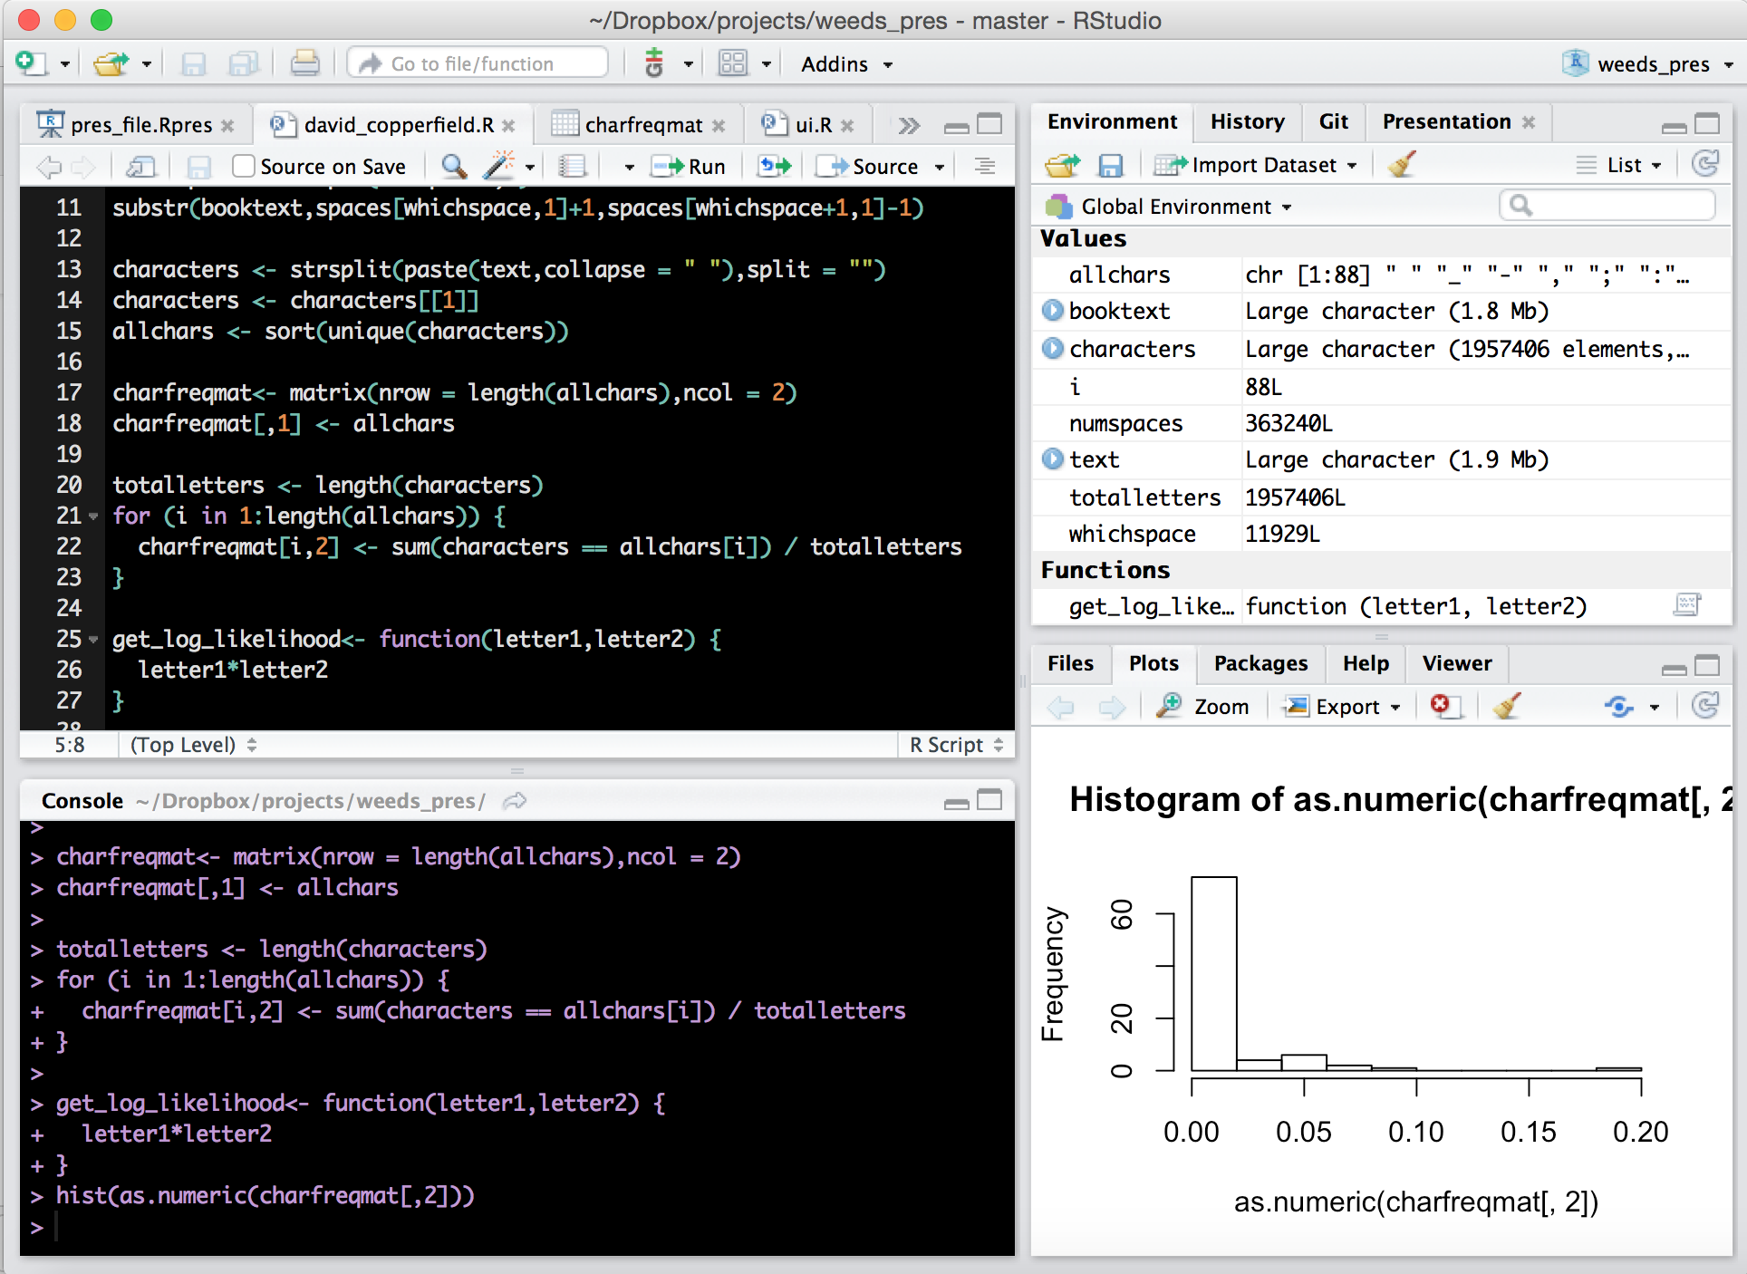

what is R?
Last login: Mon Feb 12 23:24:44 on ttys000
Patricks-MacBook-Pro:~ pmckenz1$ R
R version 3.3.2 (2016-10-31) -- "Sincere Pumpkin Patch"
Copyright (C) 2016 The R Foundation for Statistical Computing
Platform: x86_64-apple-darwin13.4.0 (64-bit)
R is free software and comes with ABSOLUTELY NO WARRANTY.
You are welcome to redistribute it under certain conditions.
Type 'license()' or 'licence()' for distribution details.
Natural language support but running in an English locale
R is a collaborative project with many contributors.
Type 'contributors()' for more information and
'citation()' on how to cite R or R packages in publications.
Type 'demo()' for some demos, 'help()' for on-line help, or
'help.start()' for an HTML browser interface to help.
Type 'q()' to quit R.
[Previously saved workspace restored]
>
R is a programming language for statistics and graphing.
We interact with R through an Interactive Development Environment (IDE) called RStudio, which has many features to make coding easier.

Slide 4
Scripting and console
Run code line-by-line
Built-in plotting and help features
Tracking of environmental variables
And more: R projects, R Markdown, R Shiny, and easy R packages

Slide 5

to success
Can you find your code from 2 years ago?
{
Organization
Readability
Reproducibility
Is your old code still useful to you?
Accessibility
Is your code easy to understand?
Can others find and use your code?
Can your mom use your code?

Slide 6
Everything happens in the context of a “self-contained project”

Slide 7
organization
my_project
R
Use a consistent file structure
dat
extra_files
Keep a directory for each project
programs
my_project.Rproj
Keep a README.txt file with every project
README.txt

Slide 8
Tool #1: R projects
An R project is just a way to save your work.
Rather than opening R files one-by-one from different places, open them within an R project.
Your previously open files will be restored when you go back to work.
Starting an R project is easy: file -> new project
Incredibly simple.
Default working domain
Default files
Self-contained workspace
Implications?
Makes it easy to bounce between multiple projects.
Encourages you to write code using local working directory.

Slide 9
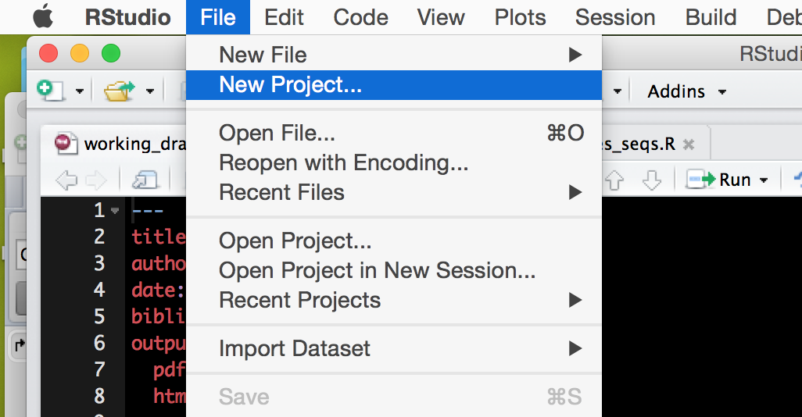

Slide 10
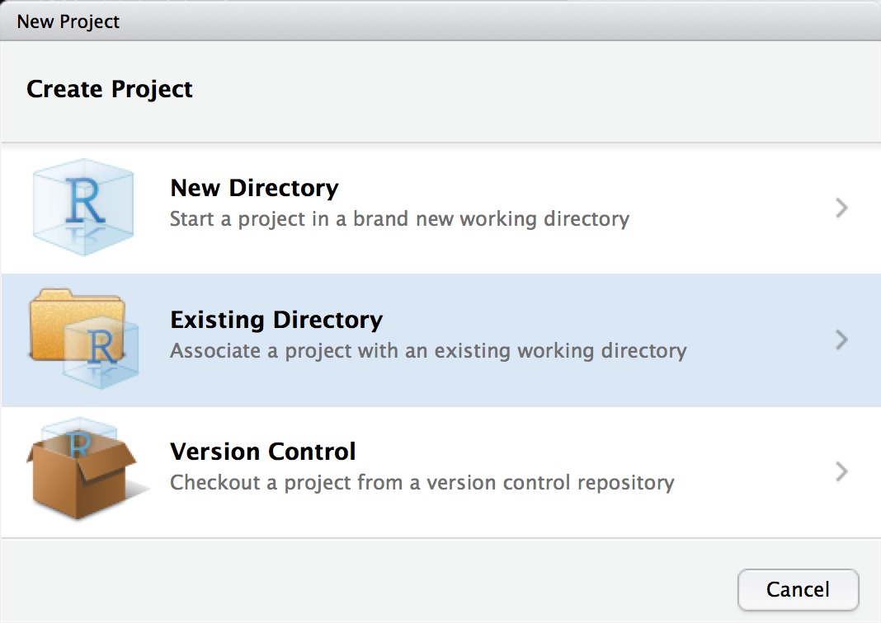

Slide 11
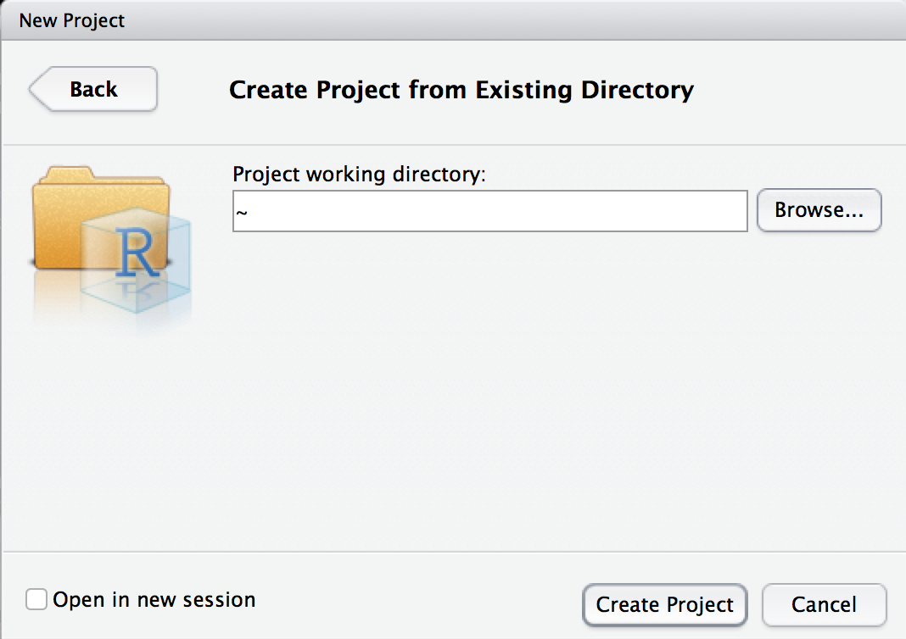

Slide 12
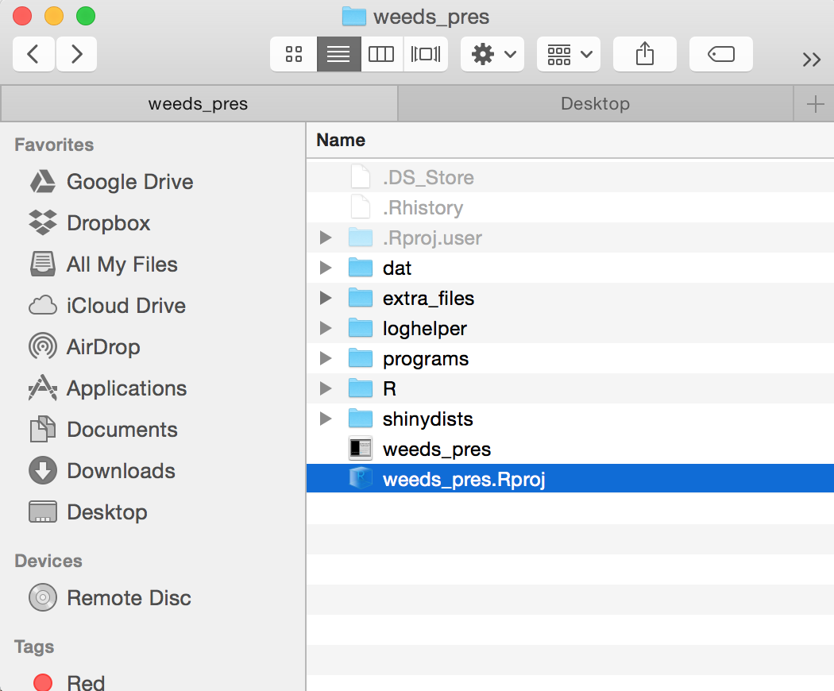

Slide 13
Examples on my own computer
getwd()
loading files
opening two projects at once
Big Idea: R Projects help you maintain discrete, self-contained projects
Ten papers (or ten computers) down the road, this will be nice.

Slide 14
Are you using a “self-contained project” approach but want to use your same R tools for a bunch of different projects?
Do you want to make your code easy for someone else to use?

Slide 15
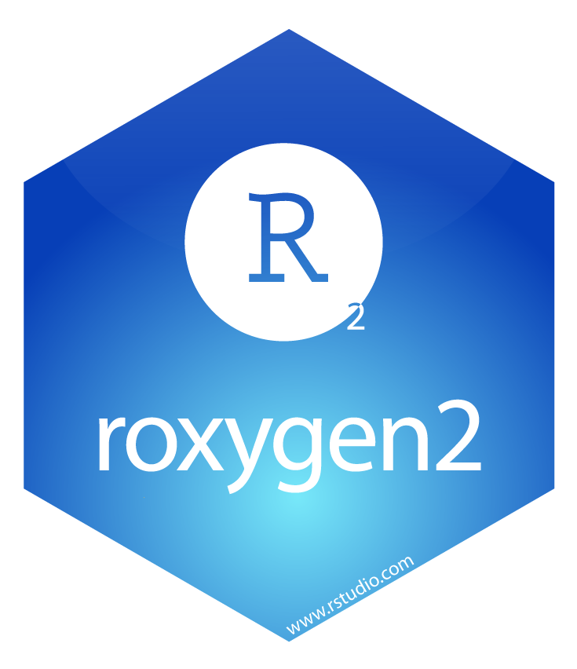
Tool #2: R Packages
(Organization and reproducibility)
Writing self-contained, well-documented code that is easy to come back to and that others can use.
Installable globally, importable globally, has metadata.

Slide 16
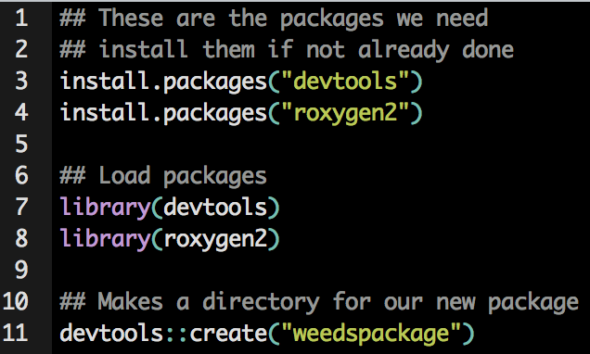
devtools and roxygen2 packages automate the process of making our own R packages

Slide 17
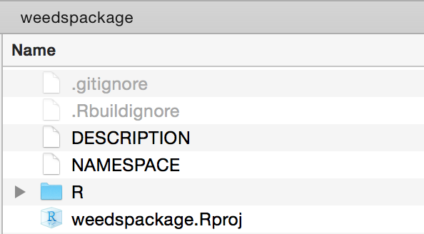
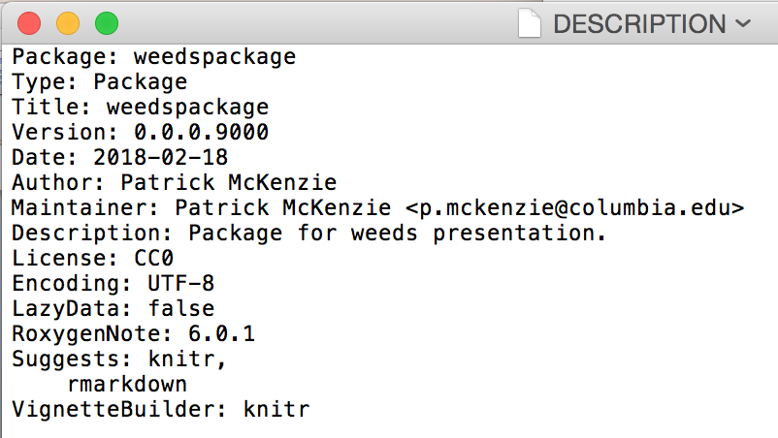
This is our new directory, automatically set up for us. Cool.
1) Manually edit the DESCRIPTION file in your new directory to include stuff like your package name, your name, the date, and the license

Slide 18
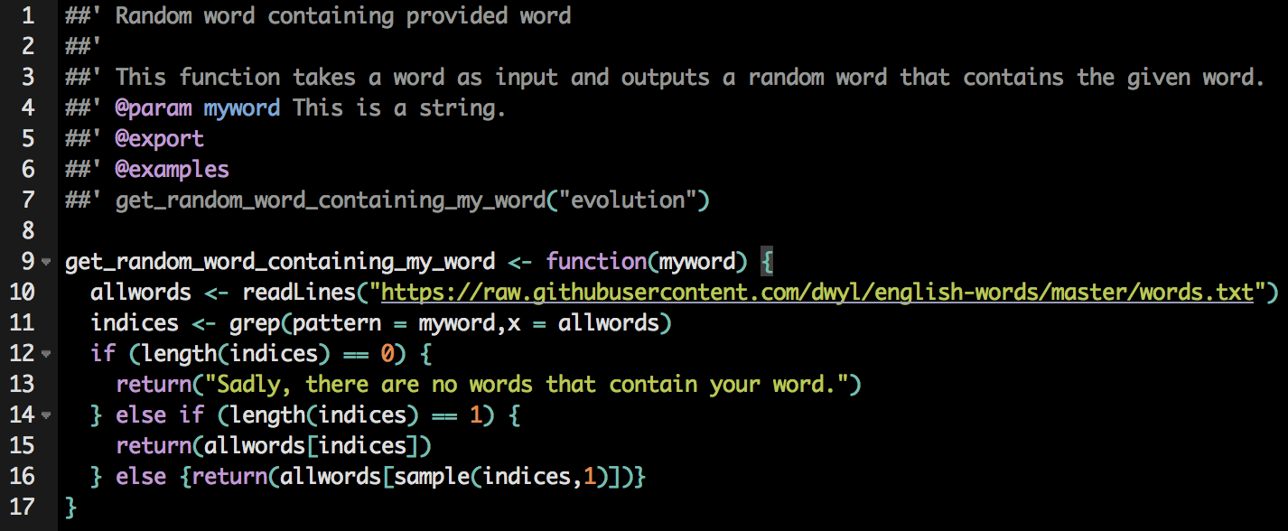
2) Write some functions – this is probably already done if you’re trying to make a package. Document them at the top using the format below.

Slide 19
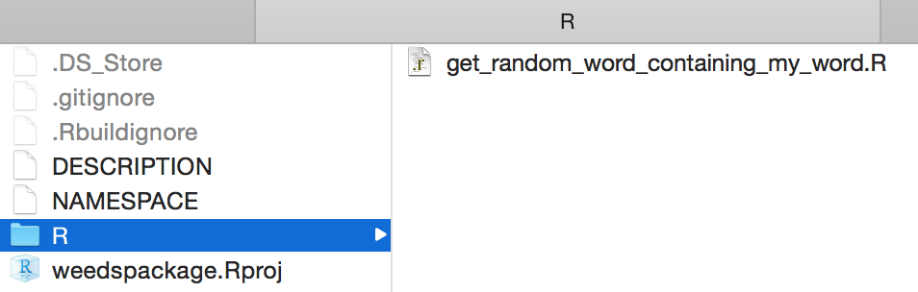
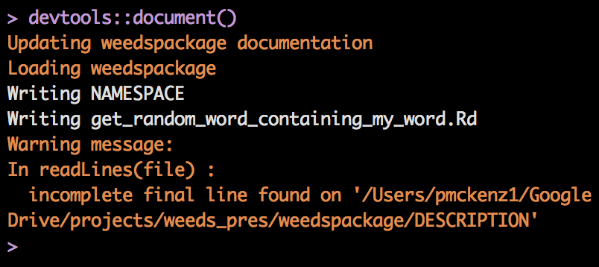
3) Save your new functions as separate R files in the “R” folder in your new directory.
4) Use the document() function to automatically create a “man” folder for your documentation

Slide 20
Our package is done!
Either:
devtools::install(“weedspackage”)
We can install it locally, or we can push it to a GitHub repo so that anyone can install it
Or (if it’s on GitHub):
devtools::install_github(“pmckenz1/weedspackage”)
Then use it like a normal package.
Next steps:
Write a vignette to explain how to use the package
library(weedsprez)
get_random_word_containing_my_word(“evolution”)
Write unit tests to make sure updates to your package don’t cause problems

Slide 21
Big Idea: Packages are easy to make.
Then other people can use your code.
This is good for replicable science.

Slide 22

Tool #3:
R Markdown
Essential for readability and reproducibility
I use these for LITERALLY everything. Research meetings, papers, homework, note-taking, whatever.
Write and format text, code, equations, and plots in the same document.
Output as .pdf or .html

Slide 23
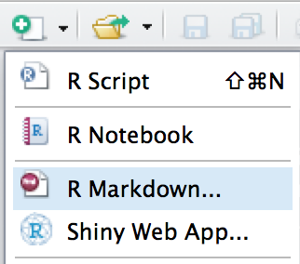
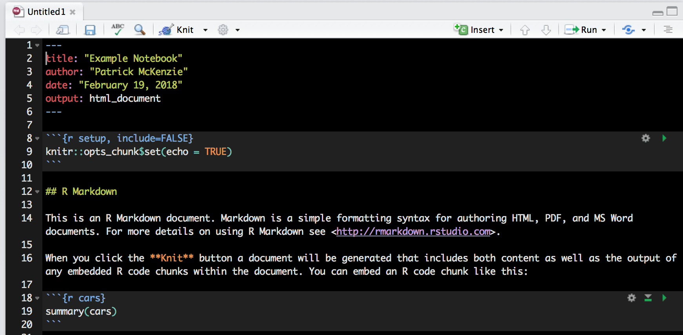
Easy to start a new markdown document from your R project.

Slide 24
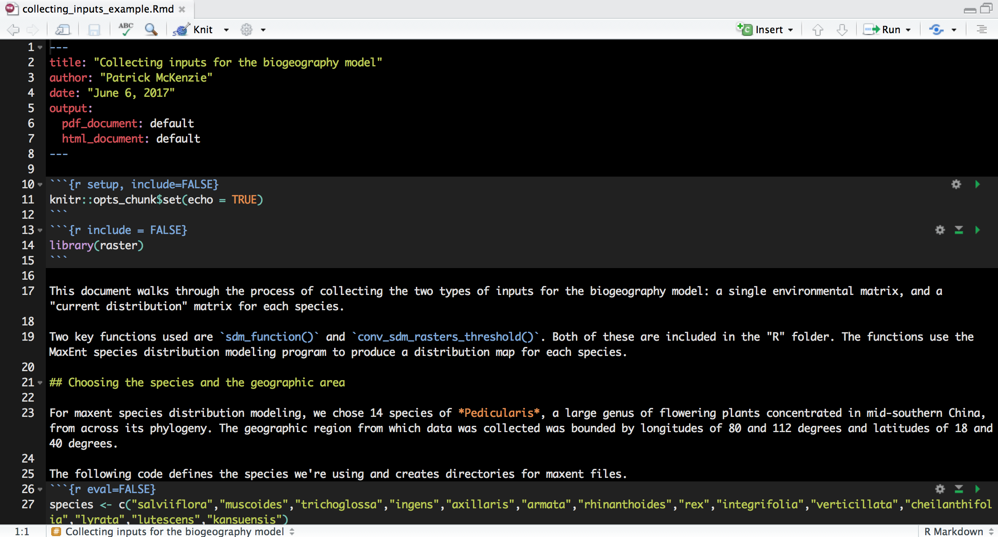

Slide 25
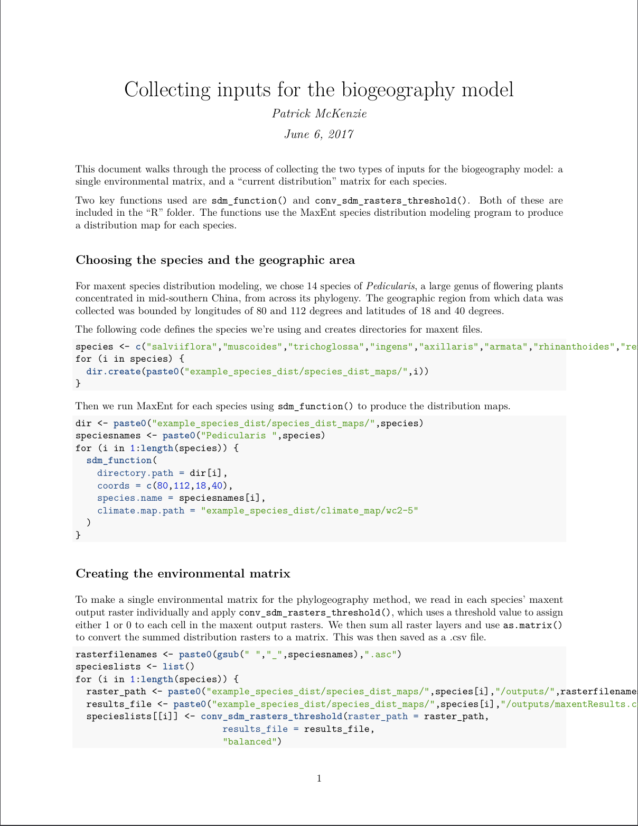
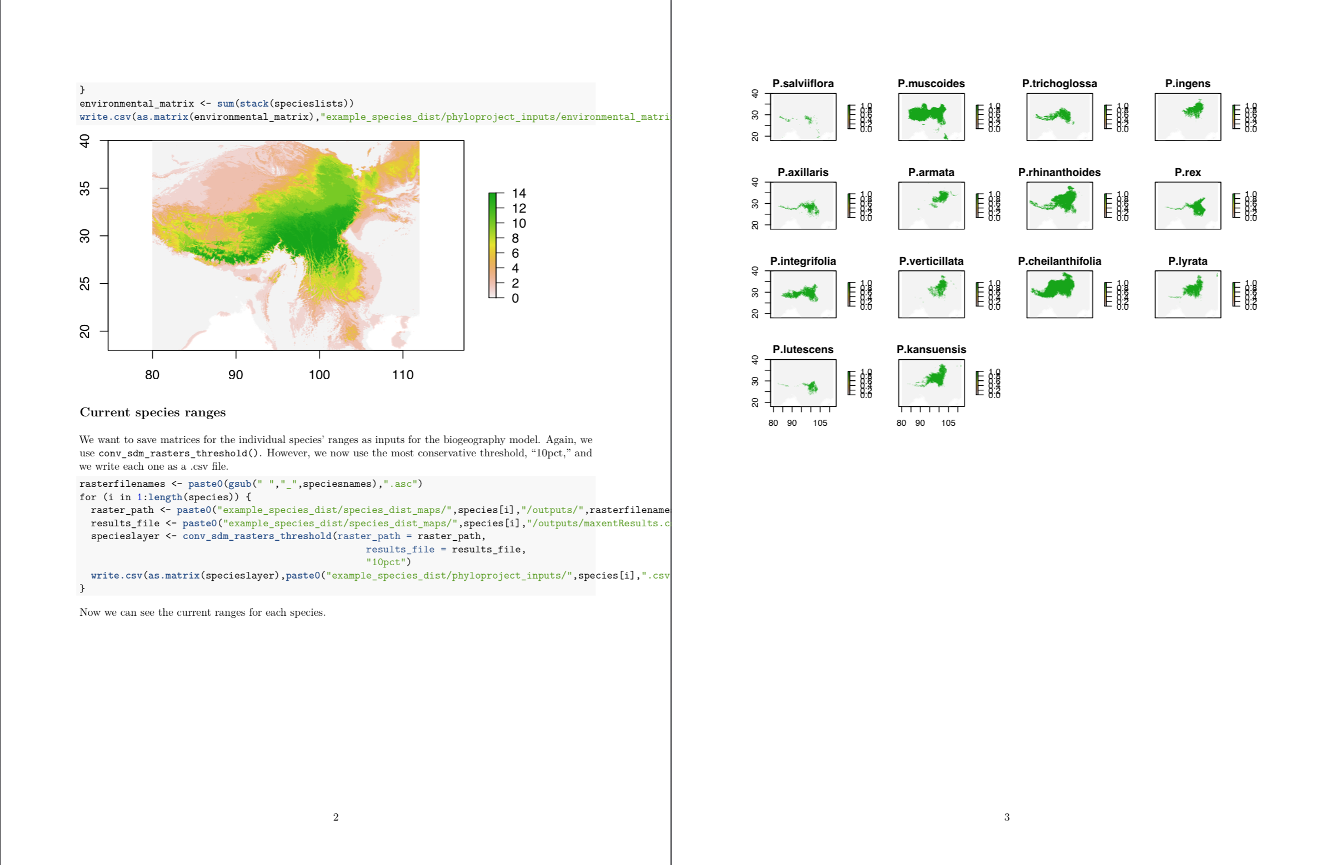

Slide 26
R Markdown Cheatsheet
https://www.rstudio.com/wp-content/uploads/2015/02/rmarkdown-cheatsheet.pdf
Big Idea: R Markdown makes presenting your project quick and easy.
And, years later, it will help you remember why you wrote your code the way you did.
Your advisor will thank you.

Slide 27

Tool #4: R Shiny
Good as a learning or teaching tool, and good for sharing your work.
Uses “reactive programming,” where code is written incorporate values from a range of possible user-provided inputs and automatically update the outputs.
Easy to host online.

Slide 28
Shiny apps exist inside a dedicated directory that must include at least these two files:
ui.R
server.R
Or just a single file, app.R, that includes ui and server objects.
ui defines the layout of the page that the user will see, including inputs (sliders, etc.) and outputs (plots, etc.)
server is a function that accepts inputs from ui and returns whatever outputs the user is supposed to see.

Slide 29
Let’s make our own simple Shiny app.

Slide 30
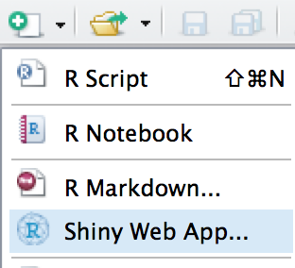
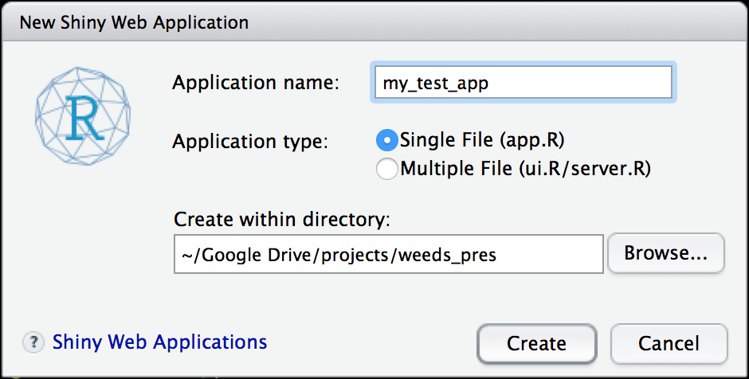
We’ll use a single file application type for simplicity. For more complicated apps, it’s cleaner to use the two separate files.
This creates a folder with our application name inside the designated directory.

Slide 31
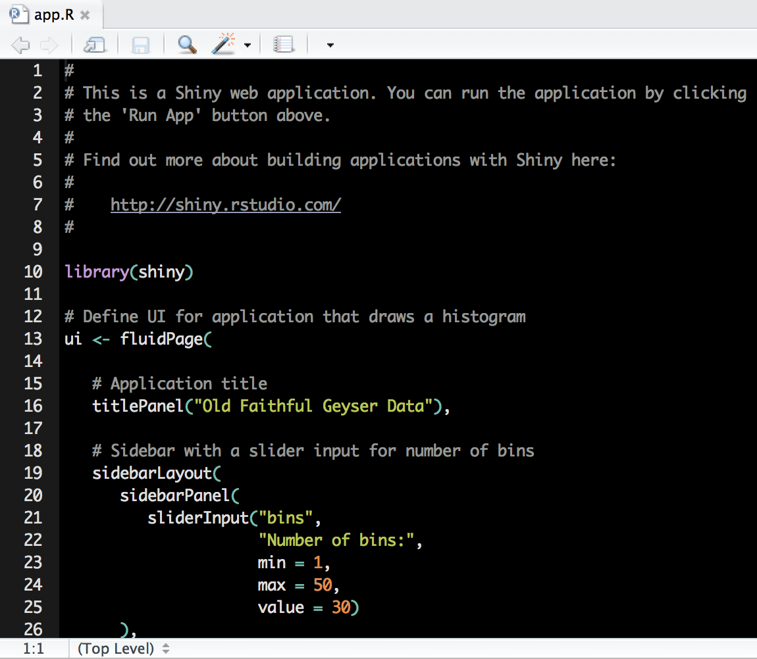

Slide 32
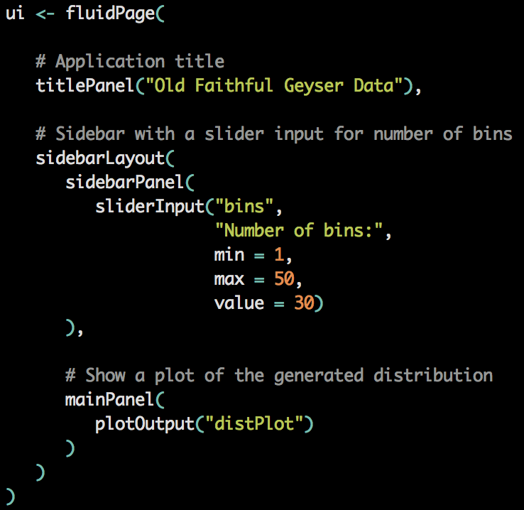
ui defines what the app user will see.
}
This app will have:
title panel labeled “Old Faithful Geyser Data”
sidebar with a single slider
}
panel to plot outputs

Slide 33
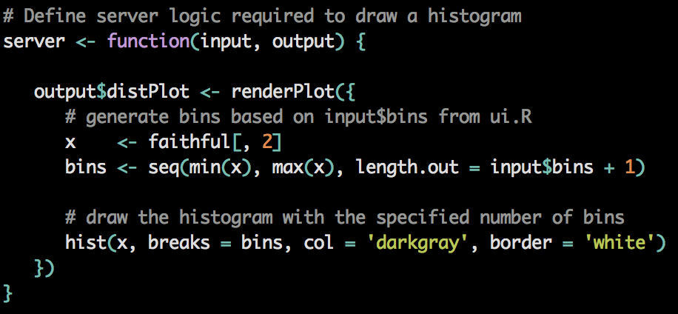
server is a function that takes user inputs and returns what the user should see.
The input here is the value from the “bins” slider.
The output plot is saved to an output list object with the name distPlot.
distPlot is what is plotted on the ui (as we defined in the previous slide).

Slide 34
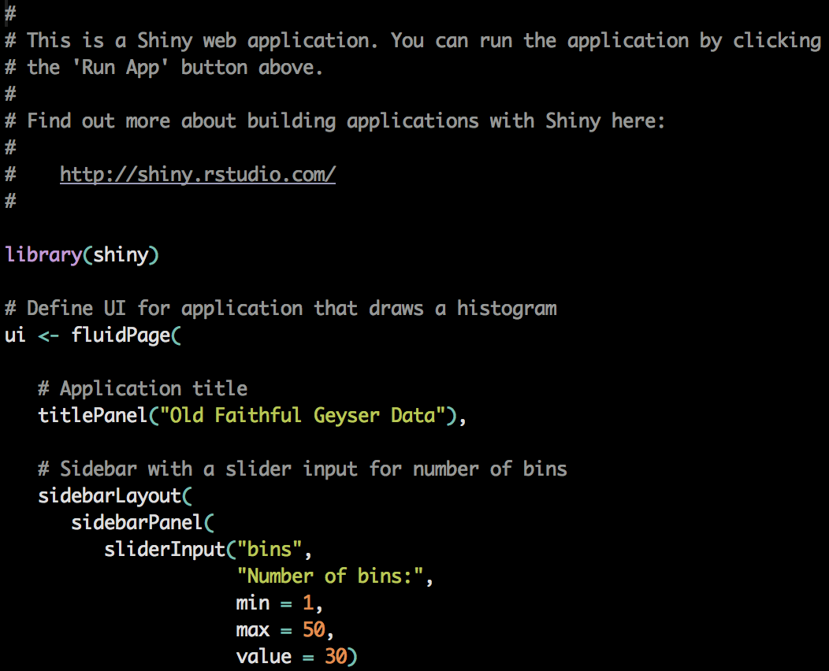
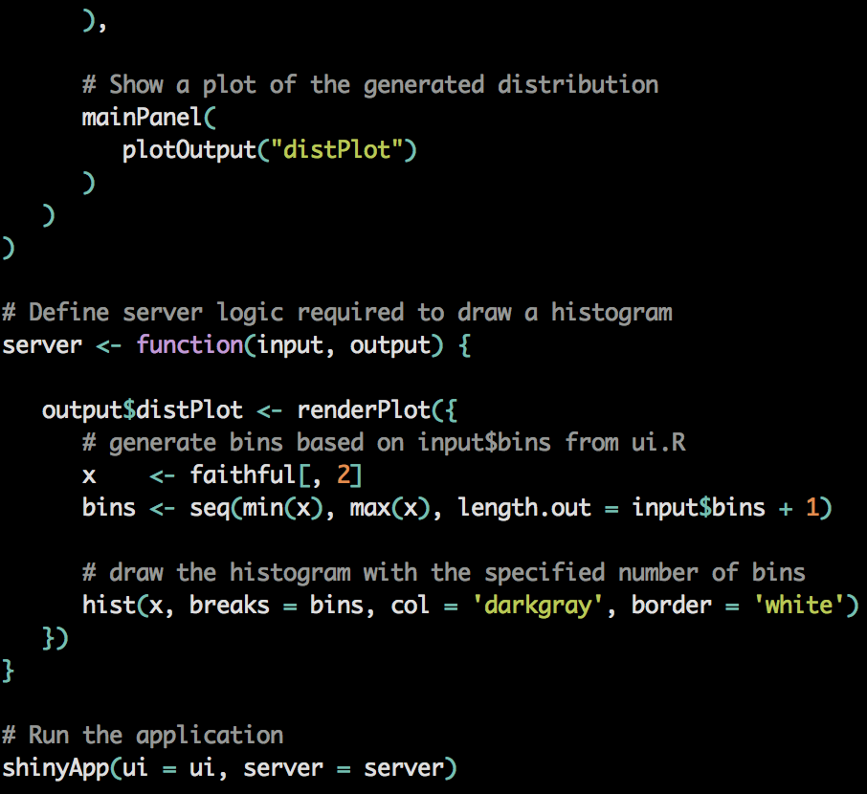

Slide 35
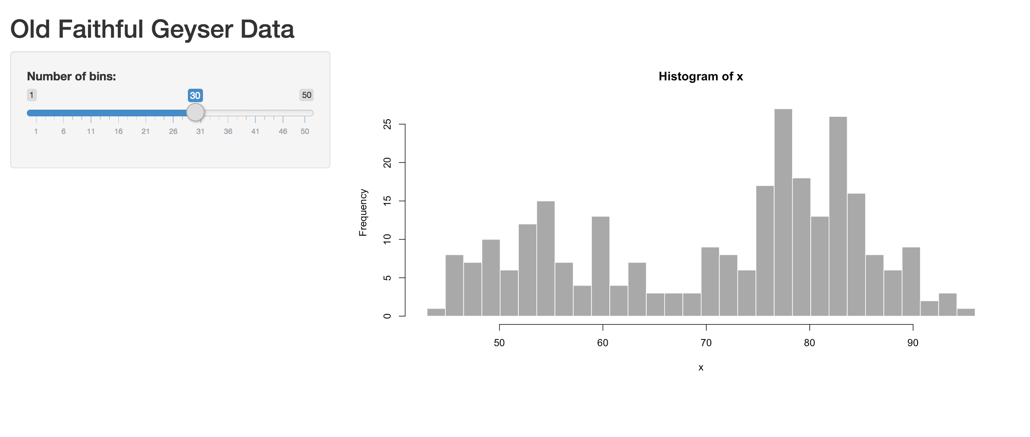

Slide 36
Let’s look at a few examples (not in this presentation file)
https://pmckenz1.shinyapps.io/loghelper/
https://pmckenz1.shinyapps.io/Deterministic_Mutualism_Model/

Slide 37
R Shiny Cheatsheet
http://shiny.rstudio.com/images/shiny-cheatsheet.pdf
R Shiny Gallery
https://shiny.rstudio.com/gallery/
Big Idea: R Shiny is good for making your work accessible to others.
Particularly good as a learning tool.

Slide 38
Conclusion
Disclaimer first:
nothing here is always best for the job
R Projects
R Packages
R Markdown
R Shiny
But using these can reinforce best practices of coding for science
Organization
Readability
Reproducibility
Accessibility
There are Python equivalents of everything here

